Slide 1
An Analysis of Competing Flows Over a Satellite Link
Kush Shah ‘23, kshah2@wpi.edu

Slide 2
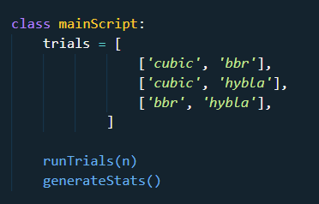
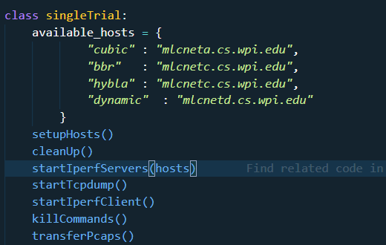

The Experiment

Slide 3
Conditions
Proxy set off
hyStart disabled for cubic
All One Gigabyte transfers

Slide 4

Kernel Socket Options

Slide 5
Some difficulty
There was an issue with the Iperf connection terminating prematurely causing odd results.
Changing the congestion control protocol on the servers did not always work
Keeping the network busy

Slide 6
Example graphs

Slide 7
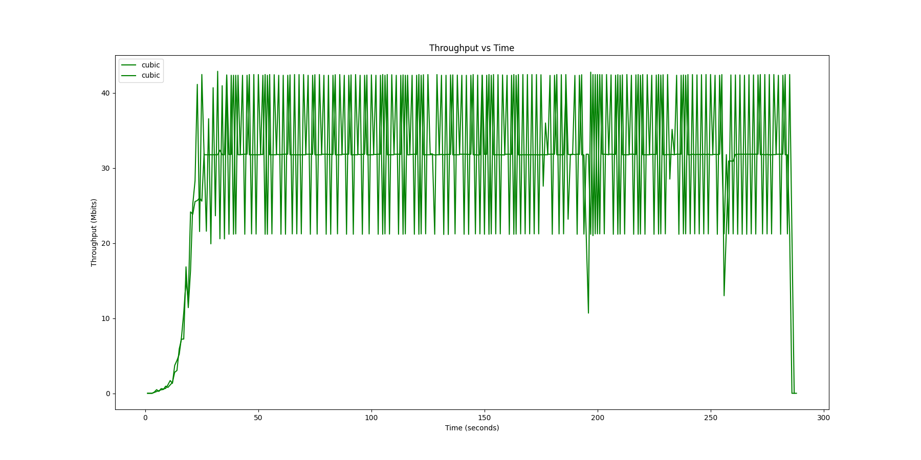
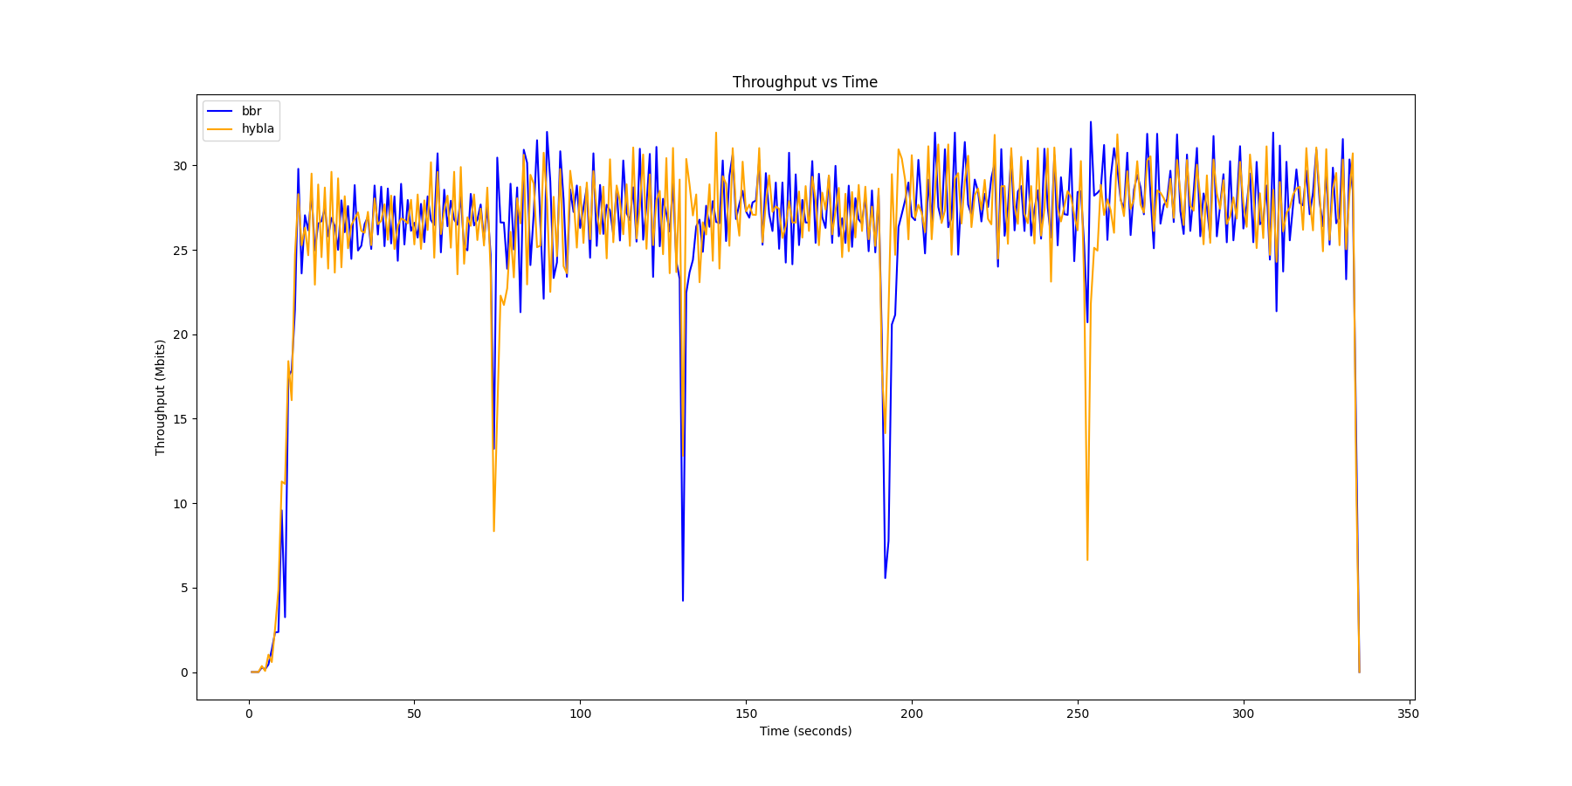
Example Graphs

Slide 8
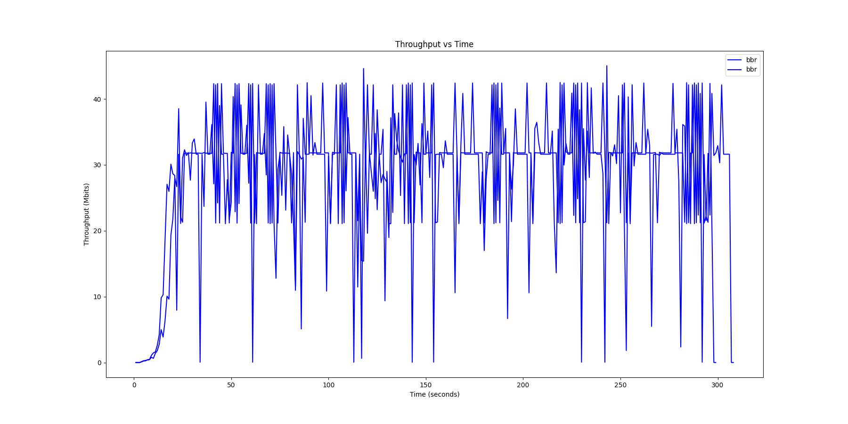
Example Graphs

Slide 9
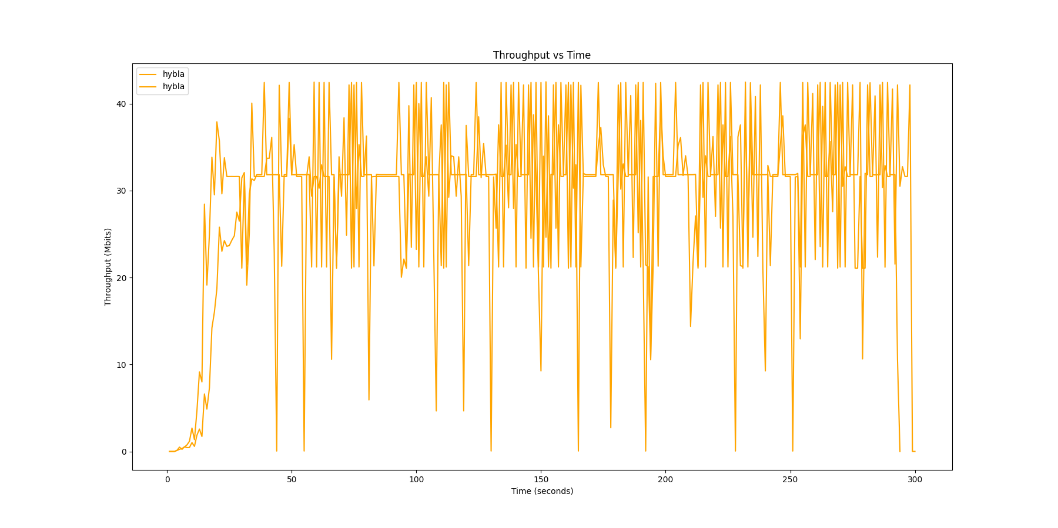
Example Graphs

Slide 10
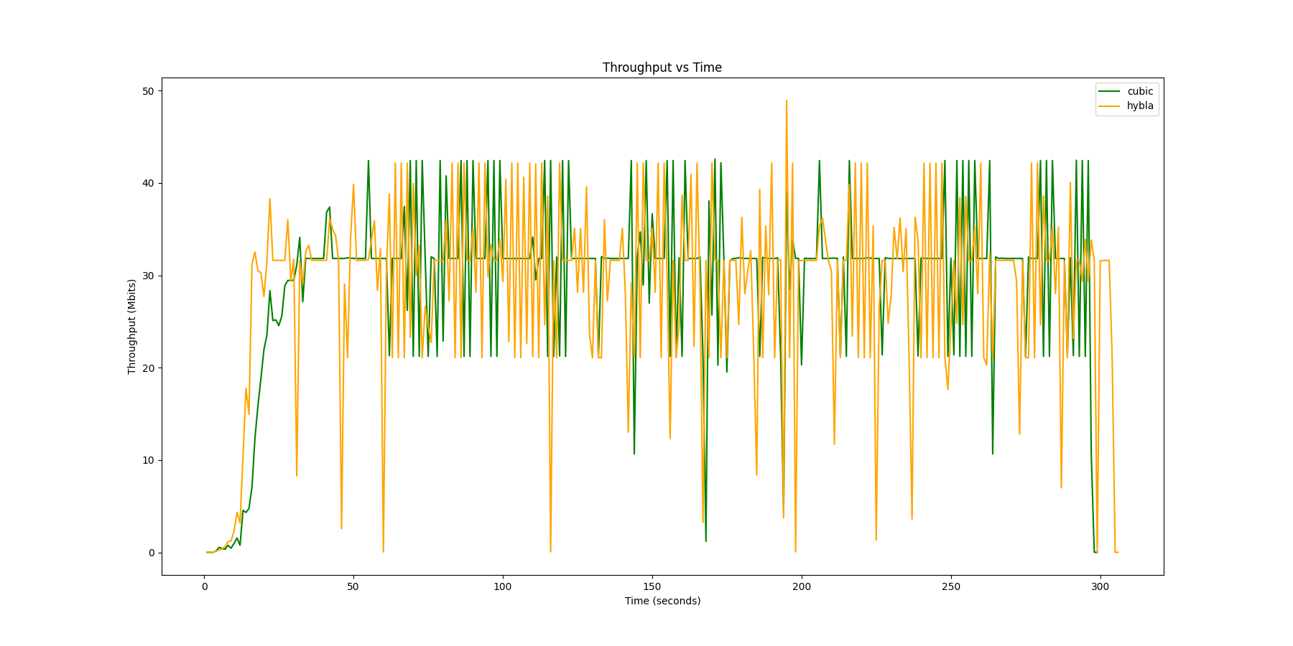
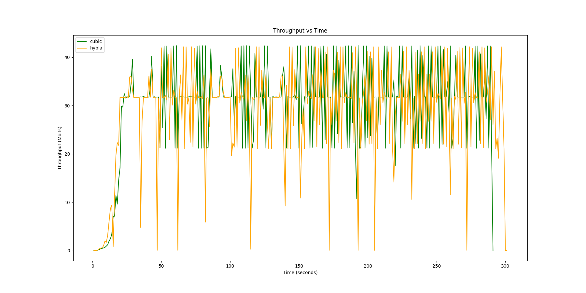
Example Graphs

Slide 11
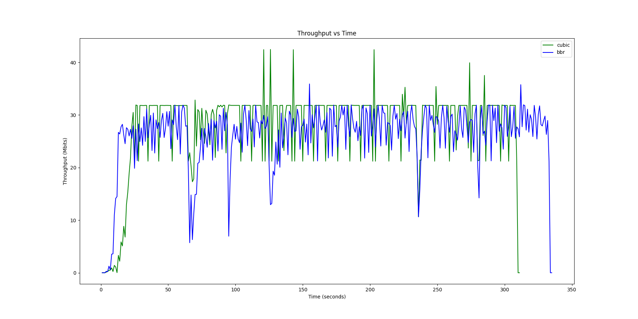
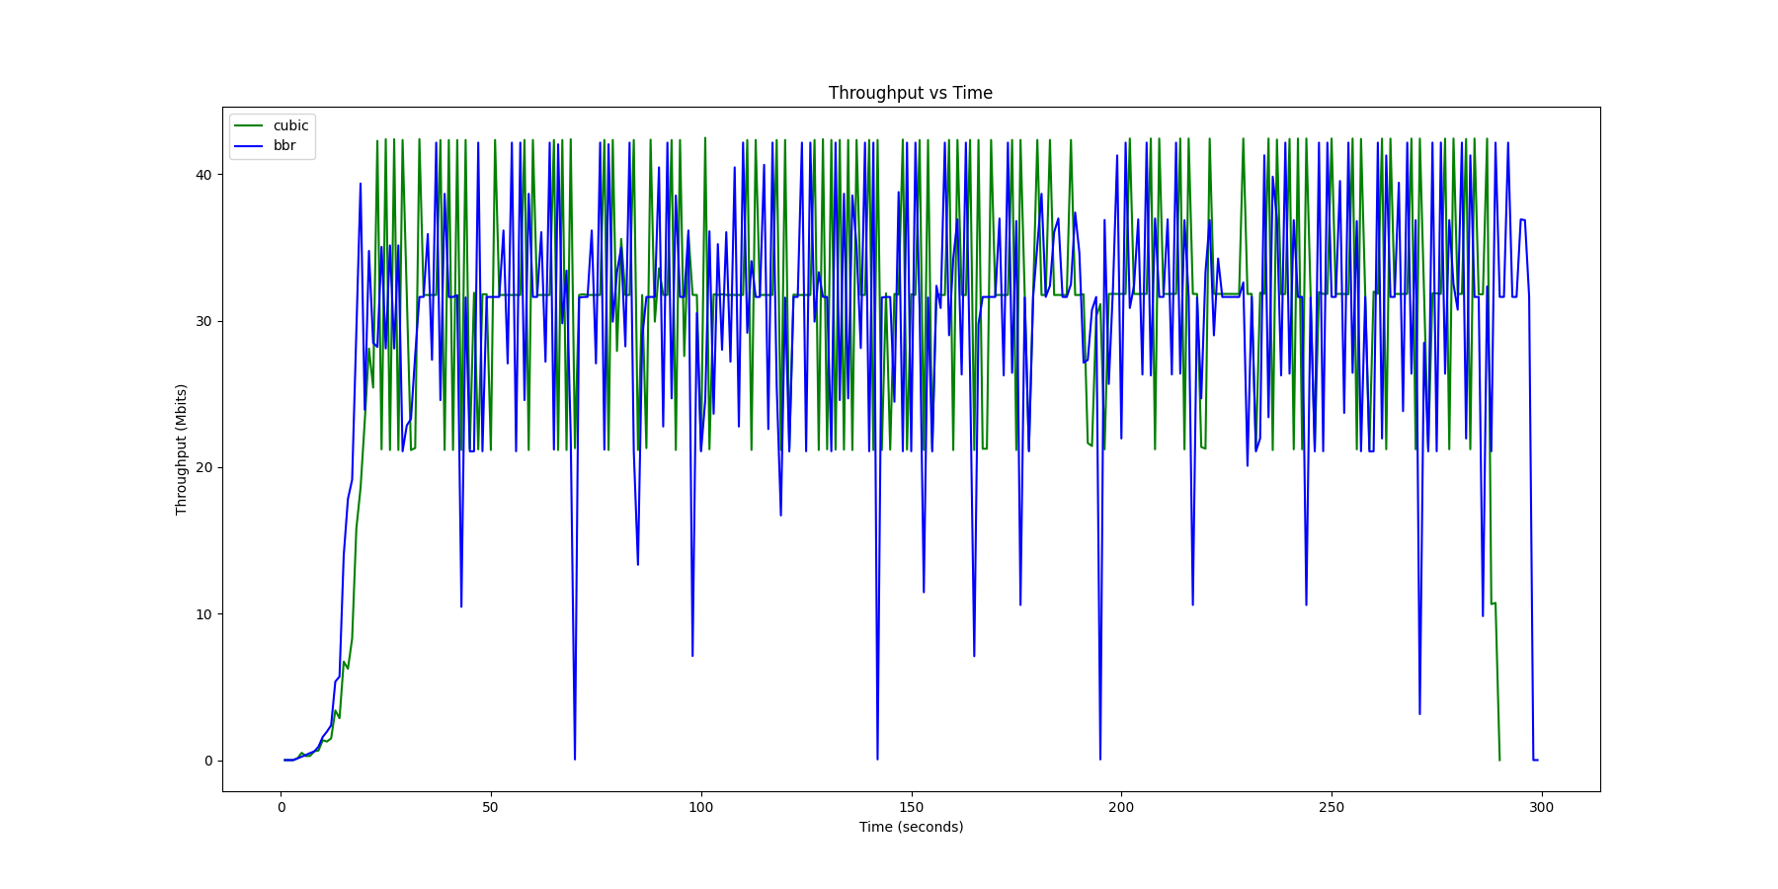
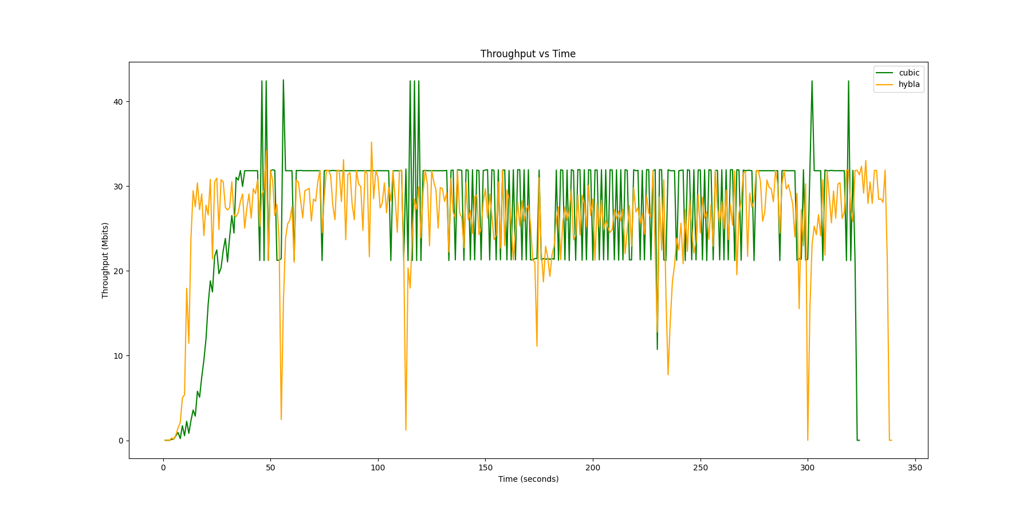
Example Graphs

Slide 12
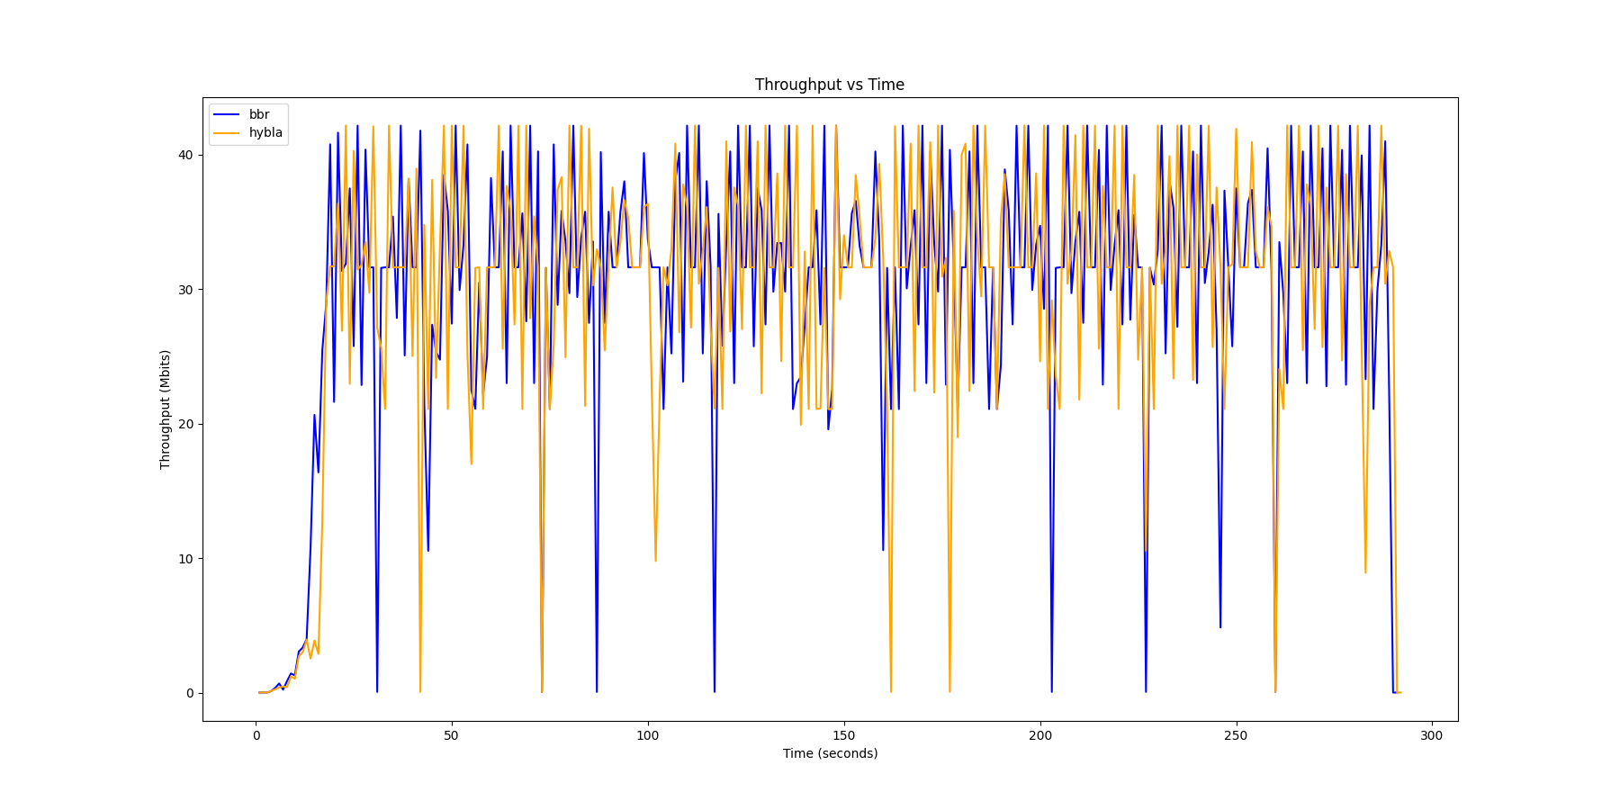
Example Graphs

Slide 13
Standout graphs

Slide 14
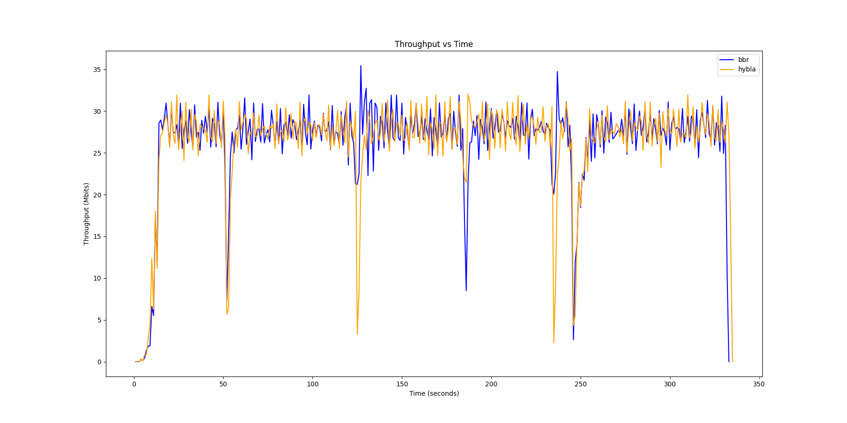
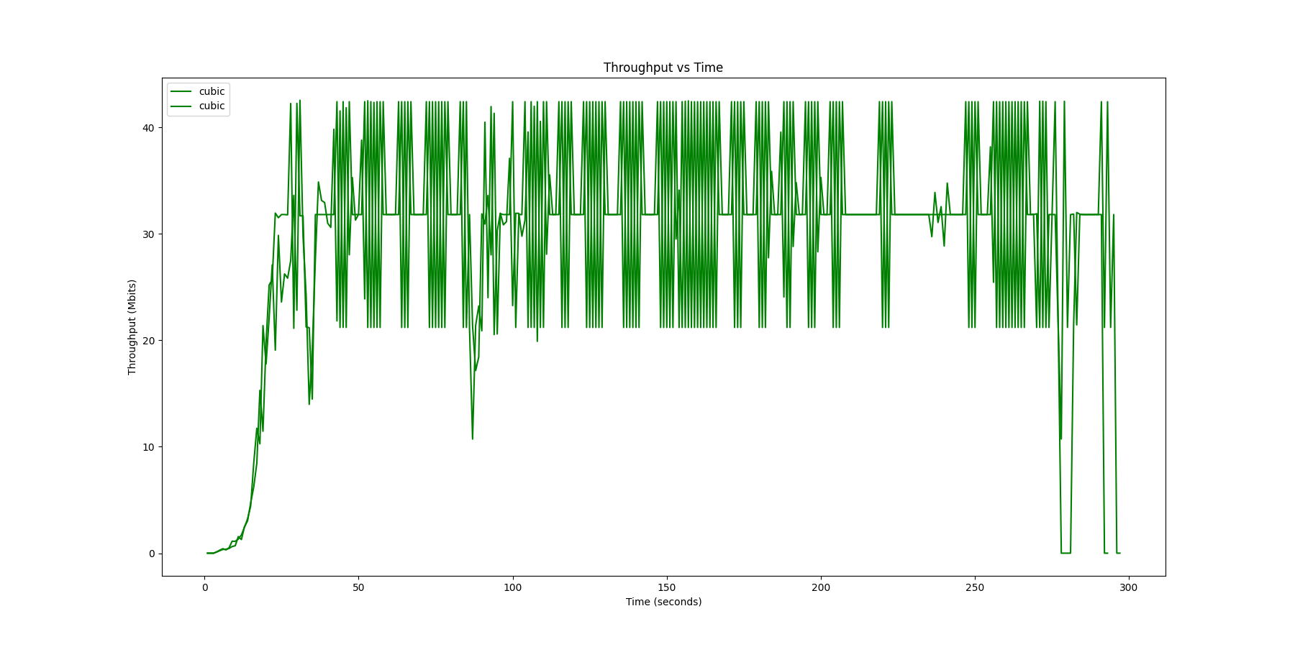
Example Graphs

Slide 15
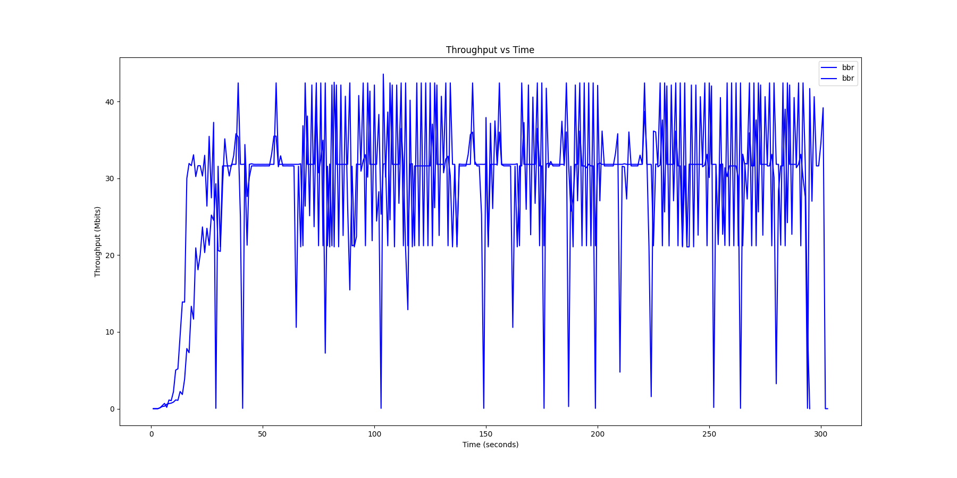
Example Graphs

Slide 16
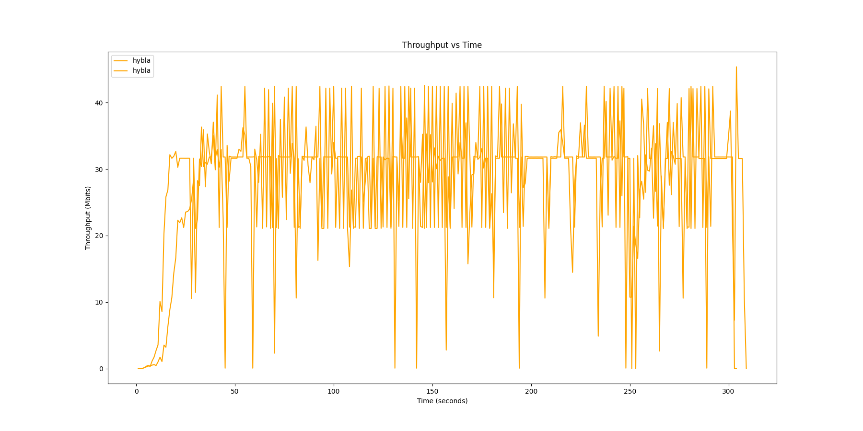
Example Graphs

Slide 17
Example Graphs

Slide 18
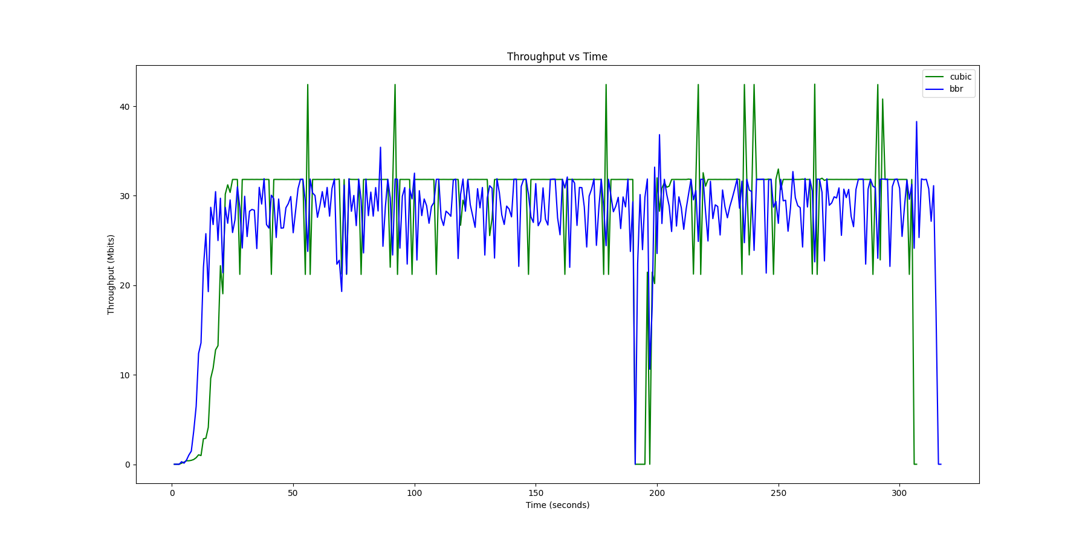
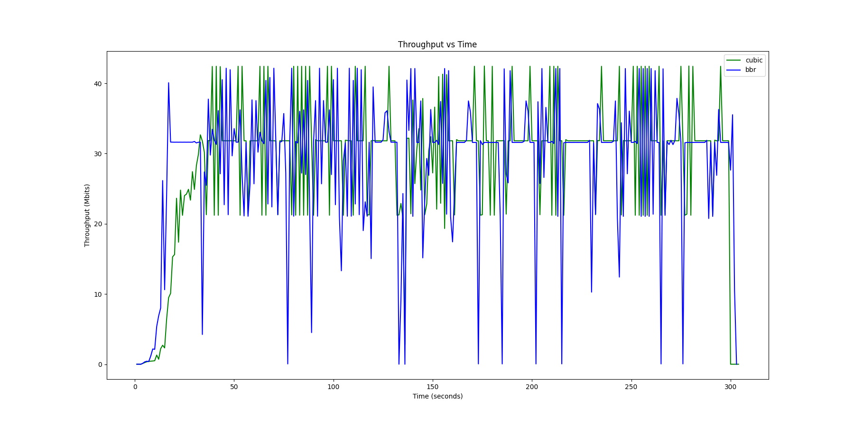
Example Graphs

Slide 19
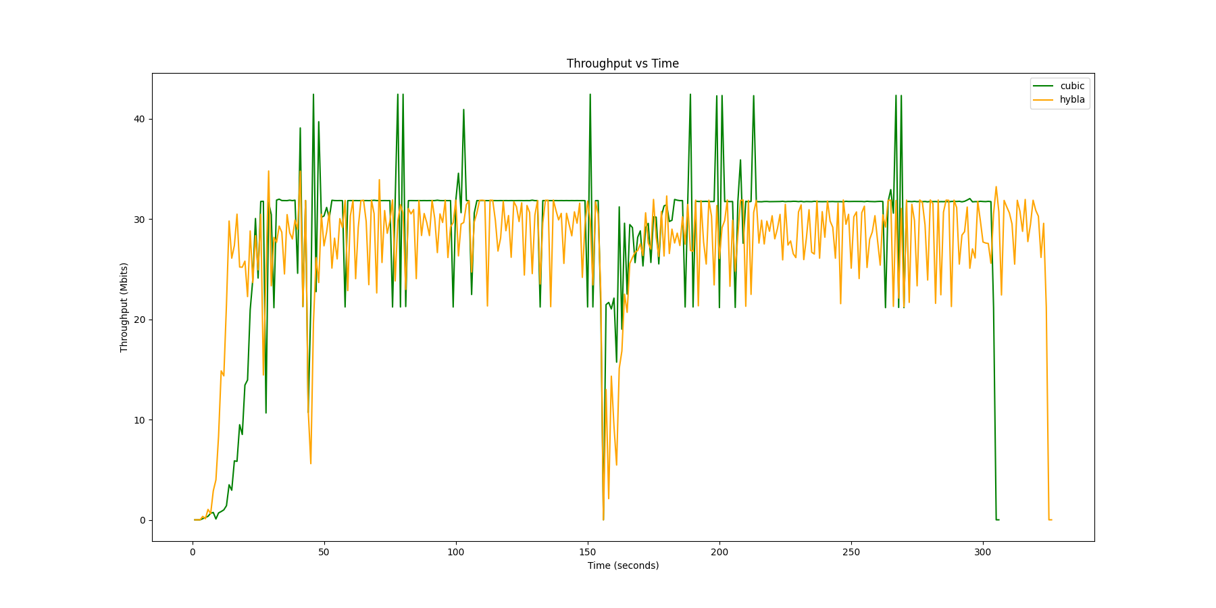
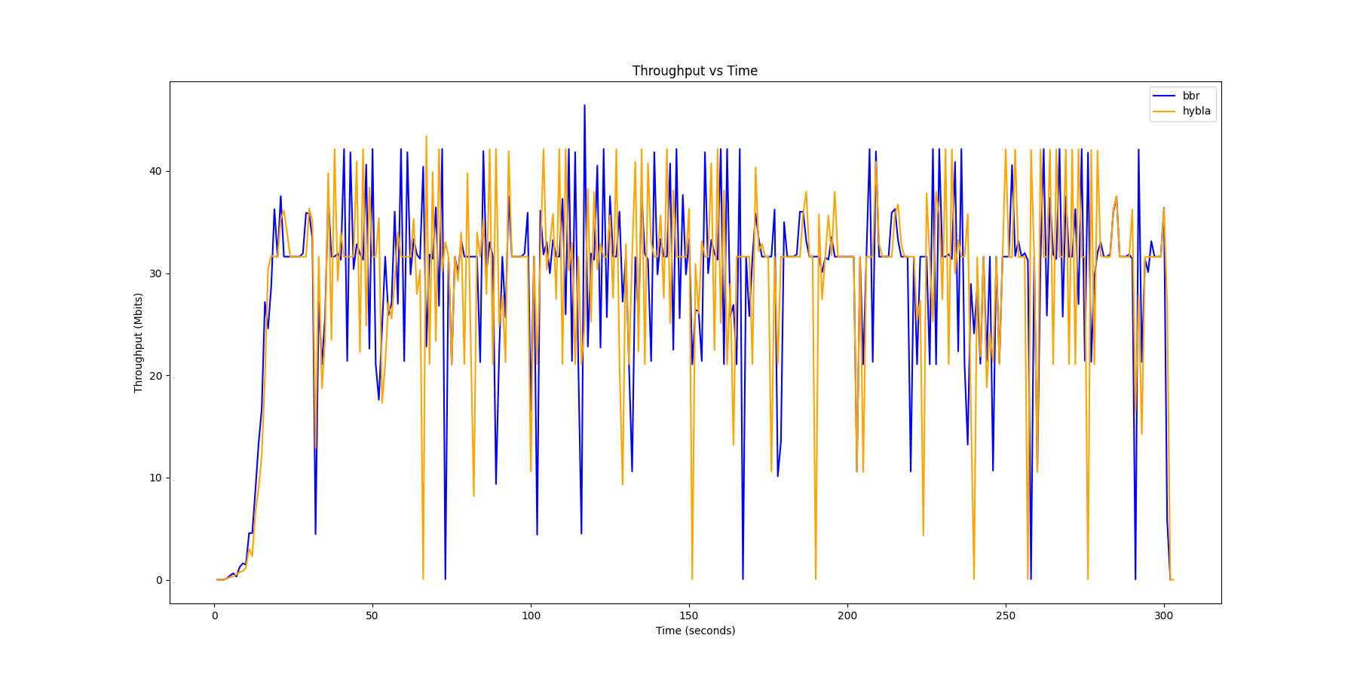
Example Graphs

Slide 20
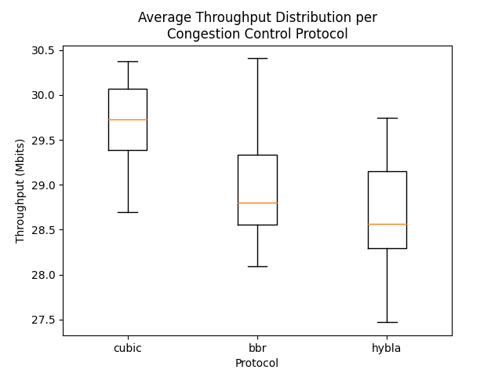
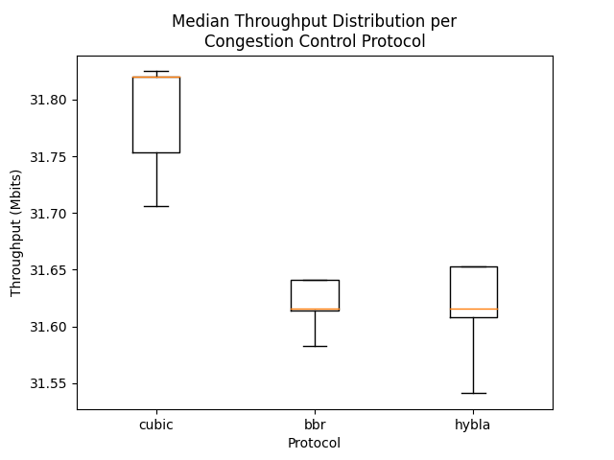
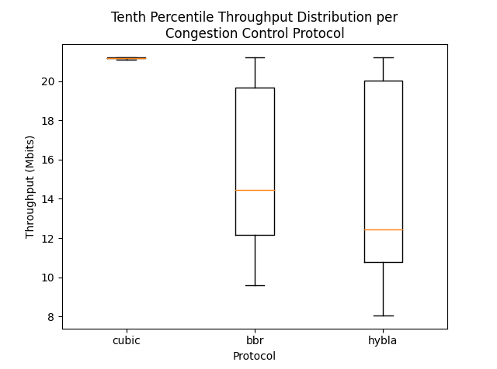
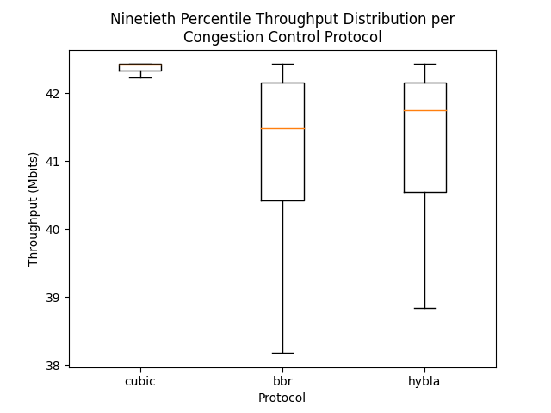
Summary

Slide 21
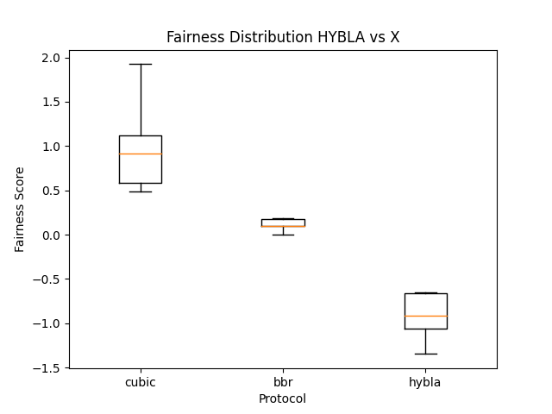
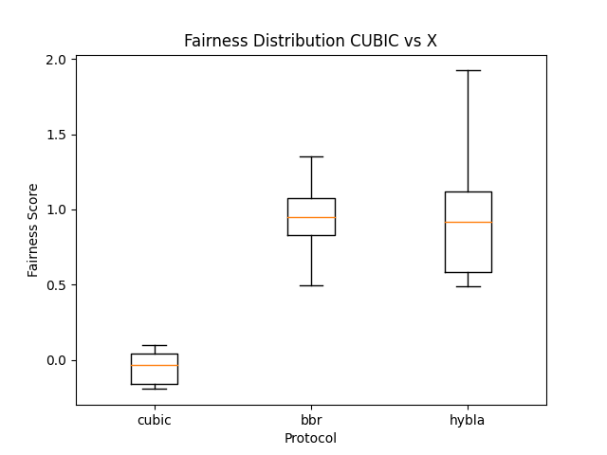
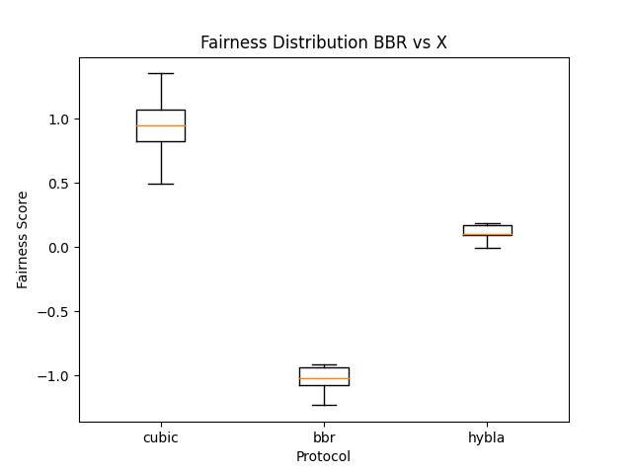
Fairness Summary

Slide 22
Extensions
Stagger Start
RTT analysis
Longer experimental phase

